Slide 1
Machine Learning Overview
Chapter 24

Slide 2
Supervised Learning
Most likely the most common type of machine learning.
Trains over historical data.
Requires the dependent variable of the historical data (that which you are trying to predict on future data) needs to already be known (i.e. labeled).
Usually an iterative process, starting on a basic model, making adjustments, with the goal of generalizing it to be able to make predictions.

Slide 3
Classification

Slide 4
Classification
Binary classification
Multiclass classification
Resulting model will make a prediction that a given items belongs to one of two groups
When we classify items into more than just two categories

Slide 5
Classification Uses
Predicting disease
Doctors use a historical dataset of behavioral and physiological attributes of a set of patients to predict whether or not a patient has heart disease
Classifying images
Classify images or label the objects in images
Prediction customer churn
Predict whether current customer likes to stop using a service
Buy or won’t buy
Predict whether visitors of their website will purchase a given product

Slide 6
Regression
When Predictions get real

Slide 7
Classification vs Regression
Similarities
Differences
Trains on historical data
Makes predictions on new data
Classification predicts a category, i.e. a discrete value
Regression predicts a real-value

Slide 8
Regression Uses
Predicting Sales
Retail companies
Drug Response Modeling
Medical field
Predicting the number of viewers of a show
Entertainment industry
Predicting Real Estate Value
Financial Forecasts
Federal Reserve

Slide 9
Spark’s Regression Algorithms

Slide 10
Linear Regression
import org.apache.spark.ml.regression.LinearRegression
https://spark.apache.org/docs/latest/ml-classification-regression.html#linear-regression

Slide 11
Generalized Linear Regression
import org.apache.spark.ml.regression.GeneralizedLinearRegression
https://spark.apache.org/docs/latest/ml-classification-regression.html#generalized-linear-regression

Slide 12
Decision Tree Regression
import org.apache.spark.ml.Pipeline
import org.apache.spark.ml.evaluation.RegressionEvaluator
import org.apache.spark.ml.feature.VectorIndexer
import org.apache.spark.ml.regression.DecisionTreeRegressionModel
import org.apache.spark.ml.regression.DecisionTreeRegressor
https://spark.apache.org/docs/latest/ml-classification-regression.html#decision-tree-regression

Slide 13
Random Forest Regression
import org.apache.spark.ml.Pipeline
import org.apache.spark.ml.evaluation.RegressionEvaluator
import org.apache.spark.ml.feature.VectorIndexer
import org.apache.spark.ml.regression.{RandomForestRegressionModel, RandomForestRegressor}
https://spark.apache.org/docs/latest/ml-classification-regression.html#random-forest-regression

Slide 14
Gradient-Boosted Tree Regression
import org.apache.spark.ml.Pipeline
import org.apache.spark.ml.evaluation.RegressionEvaluator
import org.apache.spark.ml.feature.VectorIndexer
import org.apache.spark.ml.regression.{GBTRegressionModel, GBTRegressor}
https://spark.apache.org/docs/latest/ml-classification-regression.html#gradient-boosted-tree-regression

Slide 15
Survival Regression
import org.apache.spark.ml.linalg.Vectors
import org.apache.spark.ml.regression.AFTSurvivalRegression
https://spark.apache.org/docs/latest/ml-classification-regression.html#survival-regression

Slide 16
Isotonic Regression
import org.apache.spark.ml.regression.IsotonicRegression
https://spark.apache.org/docs/latest/ml-classification-regression.html#isotonic-regression

Slide 17
Some Regression Algorithms Not in Spark’s API
Sine Regression
Lasso Regression
Multi-variate Regression
Multiple Regression

Slide 18
Recommendation

Slide 19
Recommendation
One of the most intuitive application of advanced analytics
Study people’s explicit preference (through rating) or implicit ones(though observed behavior) for various products or items
Draw similarities between the users or items
the algorithm makes recommendations to users based on what similar users liked, or what other products resemble the ones the user already purchased

Slide 20
Recommendation Uses
Movie Recommendation
Netflix uses Spark to make large-scale movie recommendation to its users
It does this by studying what movie users watch and do not watch in the Netflix
Product Recommendation
Amazon uses product recommendation as one of its main tools to increase sales
Based on the items in our shopping cart, Amazon may recommend other items that were added to similar shopping cart in the past

Slide 21
Unsupervised Learning

Slide 22
Unsupervised Learning
Different from Supervised Learning:
No Dependent Variable (i.e. no predictions to be made)
Attempts to:
Find Patterns
Discover Underlying Structure
Good for “Data Pioneering”
Could give insight to which data fields could be used in a new data set to perform supervised learning techniques on.

Slide 23
Examples
Anomaly Detection
Trained on data of standard events, can recognize non-standard events.
User Segmentation
Given a set of behaviors, casual vs frequent users/customers might display different behavior trends.
Topic Modeling
Given a set of web pages on data science, they could be clustered into pages about ML, SQL, streaming, etc… based on groups of shared/frequent vocabulary.

Slide 24
Graph Analytics

Slide 25
Graph Analytics
Less common than classification and regression
Study of structures with vertices (objects) and edges (relationships)
Ex.
Bob
drives
purchases
car

Slide 26
Graph Analytics Uses
Fraud prediction
https://www.youtube.com/watch?v=q5HFMVoN_rc
Given a historical data set of incidences of fraud, you might find user accounts within a proximity to known fraud. Say, a phone number was supplied when filling out a credit application, which is very similar to a known false application.
Anomaly detection
If the typical Facebook user has over 300 friends, then someone with a handful of friends could be a Russian spy. Or just socially awkward.
Classification
If certain vertices have a known label, then other similar vertices with similar structure could be classified under the same label.
Recommendation
Google’s original PageRank algorithm.

Slide 27
Advanced Analytics Process

Slide 28
General Process
Identify a use case for the data (see previous slides)
Collect relevant data
Clean, inspect, and understand the data
Feature engineering (ex. convert to numerical form)
Select some training data to train potential models
Evaluate and compare models on testing data
Gain insights on the data, or utilize the model for use on future data (ex. anomaly detection, predictions, solve business problems)

Slide 29
Data Collection
Gather data sets you want to leverage to train your algorithm.
Can be many files, differing file types, and different sizes.

Slide 30
Data Cleaning
Cleaning and Inspecting is also known as Exploratory Data Analysis (EDA)
Use interactive queries and visualization methods to understand distributions, correlations, and other details.
Take notice if some values need to be removed, or have been recorded incorrectly upstream, or simply missing.
Spark has many functions for this process.

Slide 31
Feature Engineering
Can often make or break a ML application, so take care in this
Tasks can include
Normalizing data
Adding variables to represent interactions of other variables
Manipulating categorical variables
Converting them to a proper format for the ML model
In MLlib, all variables will usually have to be input as vectors of doubles (regardless of what they actually represent)

Slide 32
Training Models
At this point, we have:
Historical information(e.g. spam or not spam email)
A task we would like to complete(e.g. classifying spam emails)
During the training process, the parameter inside of the model will change according to how well the model performed on the input data.
To classify spam emails, our algorithm will likely find that certain words are better predictor of spam than others and therefore weight the parameters associated with those words higher.
The output of training process is what we call a model.

Slide 33
Model Tuning and Evaluation
So, how do we know our model is any good at what it is supposed to do ?
Splitting our dataset into multiple portions allows us to objectively test the effectiveness of the trained model against a set of data that it has never seen before
Training dataset for training models
Validation set in order to try out different hyperparameters(parameters that affect the training process) and compare different variations of the same model without overfit
Test dataset for the final evaluation of our different model variations to see which one performed the best
Avoid overfitting(training a model that does not generalize well to new data)

Slide 34
Leveraging the Data
You are now ready to use it!
Taking your model to production can be a significant challenge

Slide 35
Spark’s Advanced Analytics Toolkit
Sparks includes several core packages and many external packages for performing advanced analytics.
MLlib is primary package, which provides an interface for building machine learning pipelines

Slide 36
What Is MLlib?
A package built on and include in Spark
It provides interfaces for
gathering and cleaning data
feature engineering and feature selection
training and tuning large scale supervised and unsupervised machine learning models, and using this models in production
MLlib consists of two package that leverage different core data structure
org.apache.spark.ml (include an interface for using Data Frame and building ML piplines)
org.apache .spark.mllib (Spark’s low-level RDD APIs)

Slide 37
When and Why Should you use Mllib?
Limitations of other single machine learning tools
Size of data you can train on
Processing time
When should we use Spark
Preprocessing and feature generation to reduce the amount of time it might take to produce training and test sets from a large amount of data
When your input data or model size become to difficult or inconvenient to put on one machine, use Spark to do the heavy lifting.

Slide 38
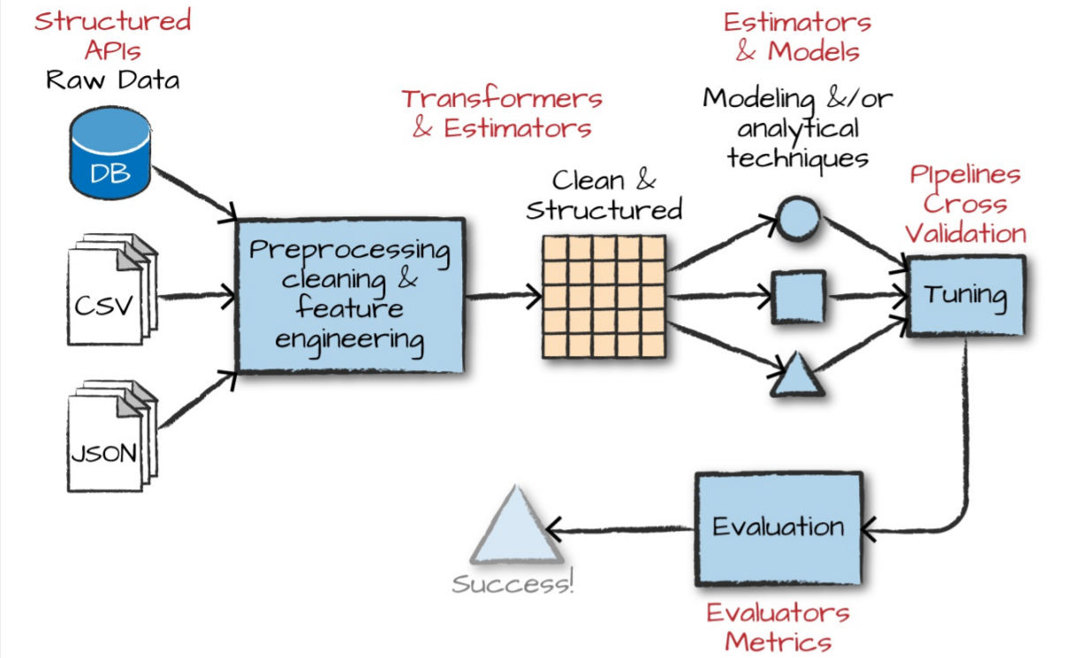
High-Level MLlib Concept

Slide 39
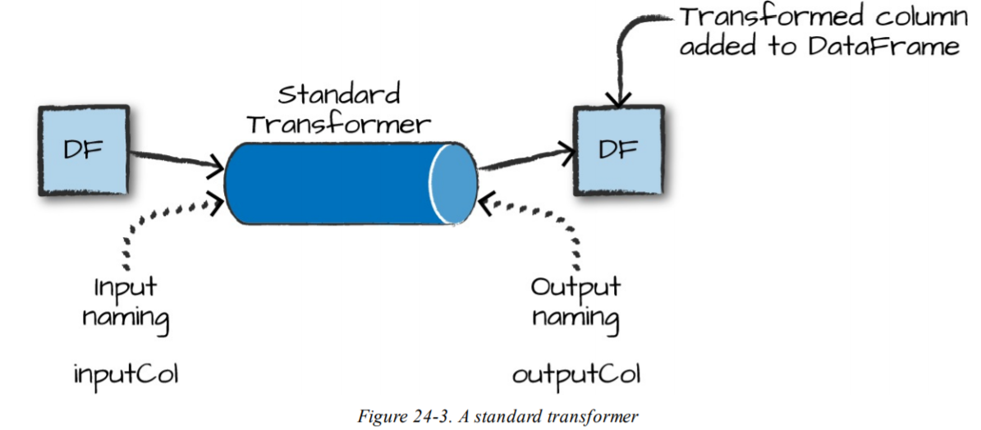
High-Level MLlib -Transformers
Transformers are functions that convert raw data in some way
Used in processing and feature engineering
Take a DataFrame as input and produce a new DataFrame as output

Slide 40
High-Level MLlib - Estimator &Evaluator
Estimator are one of two kinds of things
First, can be a kind of transformer that is initialized with data
Second, it applies the generated function over the data
Algorithms that allow user to train a model from data are also referred to as estimators
An evaluator allows us to see how a given model performs according to criteria we specify like a receiver operating characteristic (ROC)curve

Slide 41
Low-level Data Types
Whenever we pass a set of features into machine learning model, we must do it as a vector that consists of Double
Types of vector
Sparse(where most of elements are zero)
Best format
When the majority of values are zero as this is a more compressed representation
Dense(where there are many unique values)

Slide 42
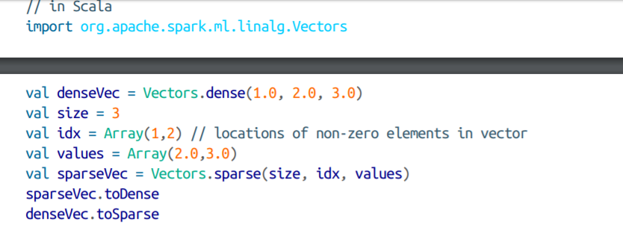
Low-level Data Types
WARNING
Confusingly, there are similar datatypes that refer to ones that can be used in DataFrames and others that can only be used in RDDs. The RDD implementations fall under the mllib package while the DataFrame implementations fall under ml.

Slide 43
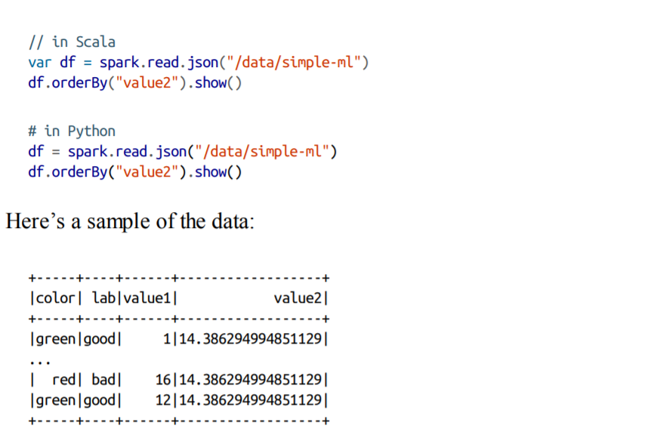
MLlib in Action

Slide 44
Feature Engineering with Transformers
All inputs to machine leaning algorithms in Spark must consist of type Double(for label) and Vector[Double](for features)
RFormula
~ Separate target and terms
+ Concat terms; “+ 0” means removing the intercept (this means that the y-intercept of the line that we will fit will be 0)
- Remove a term; “- 1” means removing the intercept (this means that the y-intercept of the line that we will fit will be 0—yes, this does the same thing as “+ 0”
: Interaction (multiplication for numeric values, or binarized categorical values)
. All columns except the target/dependent variable

Slide 45
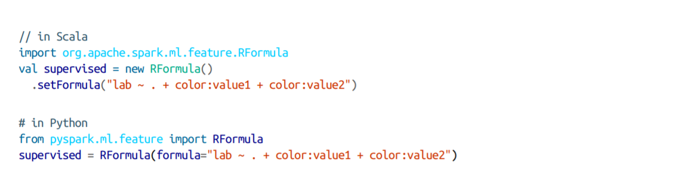
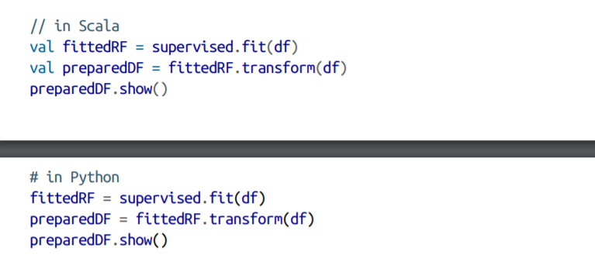
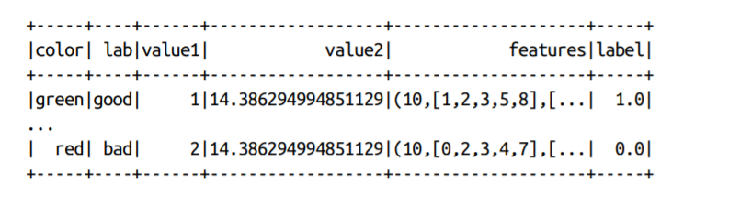

Slide 46
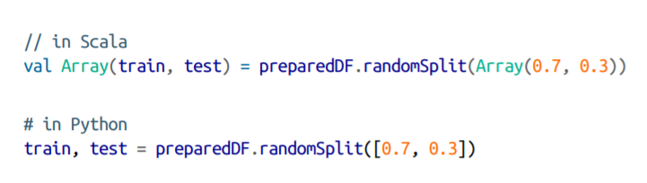
Create a Test Set

Slide 47
Estimators
The example problem in the book uses a classifier algorithm called logistic regression to fit our model.
lr = LogisticRegression(labelCol=“label”, featuresCol=“features”)
“label” and “features” are the default labels for all estimators in Spark MLlib.
Inspecting the parameters is a great way to remind yourself of the options available for every ML algorithm.
println(lr.explainParams())

Slide 48
Estimators cont.
val fittedLR = lr.fit(train)
This will launch a Spark job to train the model.
Previously, as in our transformations, they are lazy executions. This is not a lazy execution, and is performed immediately.
Once this has been completed, you are now ready to start making predictions.
Predictions are made with the “transform” method.

Slide 49
Estimators cont.
Now we can manually evaluate our model.
Using metrics to check performance:
True positives
False positives
True negatives
False negatives

Slide 50
Estimators cont.
Experiment with other parameters and check to see if our model is better/worse.
This is helpful, but can be tedious.
Spark lets you specify your workload as a declarative pipeline of work which includes all your transformations, including tuning hyperparameters.
Hyperparameters – Configuration parameters that affect the training process.
Ex. Model architecture, Regularization
Set prior to starting training
Again, println(<model name>.explainParams()) is a good way to see which parameters are available

Slide 51
Pipelining Our Workflow

Slide 52
Pipelining Our Workflow cont.
With lots of transformations, writing all the steps in code, and keeping track of the different DFs, it can become confusing.
Spark helps by including a Pipeline concept.
A pipeline sets up a dataflow for the pertinent transformations, which gives you an estimator that is already tuned to your specifications, yielding a ready to use tuned model.
Instances of transformers or models should NOT be reused across different pipelines. Always create a new instance of a model, before creating another pipeline.

Slide 53
Pipelining Our Workflow cont.
To avoid overfitting, create a “holdout” test set.
Tune your hyperparameters based on a validation set.
Ex. val Array(train, test) = df.randomSplit(Array(0.7, 0.3))

Slide 54
Pipelining Our Workflow cont.
Once you have a holdout test set, you can now create the base stages in the pipeline.
A stage represents a transformer or an estimator.
Ex. RFormula() https://spark.apache.org/docs/2.2.0/ml-features.html#rformula
This will analyze the data to understand the types of input features, and then transform them to create new features.

Slide 55
Pipelining Our Workflow cont.
Following the RFormula, we could call the LogisticRegression() algorithm, which we will use to produce a model.
val rForm = new RFormula() val lr = new LogisticRegression().setLabelCol(“label”).setFeaturesCol(“features”)

Slide 56

Pipelining Our Workflow cont.
Instead of manually coding transformations and tuning, we make them stages in the overall pipeline.
import org.apache.spark.ml.Pipeline val stages = Array(rForm, lr) val pipeline = new Pipeline().setStages(stages)
It’s very nice!

Slide 57
Training and Evaluation
Now we can begin training.
In the book, they don’t want to train just one model, but to train several variations of the model, specifying different combinations of hyperparameters, to test.
From there, we will select the best model using an Evaluator, testing their predictions.

Slide 58
Training and Evaluation cont.
Ex. import org.apache.spark.ml.tuning.ParamGridBuilder val params = new ParamGridBuilder() .addGrid(rForm.formula, Array( “lab ~ . + color:value1”, “lab ~ . + color:value1 + color:value2”)) .addGrid(lr.eslaticNetParam, Array(0.0, 0.5, 1.0)) .addGrid(lr.regParam, Array(0.1, 2.0)) .build()
2 different versions of RFormula
3 different options for ElasticNet parameter
2 different options for regularization parameter
Thus 12 different versions of logistic regression.

Slide 59
Training and Evaluation cont.
Evaluation process is next.
The Evaluator allows us to automatically compare multiple models.
There are different evaluators within Classification, and Regression.
The book’s example uses BinaryClassificationEvaluator and its “areaUnderROC” (Receiver Operating Characteristic).

Slide 60
Training and Evaluation cont.
import org.apache.spark.ml.evaluation.BinaryClassificationEvaluator val evaluator = new BinaryClassificationEvaluator() .setMetricName(“areaUnderROC”) .setRawPredictionCol(“prediction”) .setLabelCol(“label”)

Slide 61
Training and Evaluation cont.
We now have a pipeline specifing how our data should be transformed, performing model selecting (which tries out different hyperparameters in the regression model), and compares their performance using the areaUnderROC metric.
Remember, it’s best practice to fit hyperparameters on a validation split, and not the “holdout” test set.

Slide 62
Training and Evaluation cont.
import org.apache.spark.ml.tuning.TrainValidationSplit val tvs = new TrainValidationSplit() .setTrainRatio(0.75) // default value .setEstimatorParamMaps(params) .setEstimator(pipeline) .setEvaluator(evaluator)

Slide 63
Training and Evaluation cont.
Once you run the entire pipeline, this will test every version of the model against the validation set.
Note: tvsFitted has a return type TrainValidationSplitModel. val tvsFitted = tvs.fit(train)
And now test how it performs on the “holdout” test set. evaluator.evaluate(tvsFitted.transform(test))

Slide 64
Training and Evaluation cont.
Some models let you see a training summary. You must extract it from the pipeline, cast to a proper type, and print the results. import org.apache.spark.ml.PipelineModel import org.apache.spark.ml.classification.LogisticRegressionModel val trainedPipeline = tvsFitted.bestModel.asInstanceOf[PipelineModel] val TrainedLR = trainedPipeline.stages(1).asInstanceOf[LogisticRegressionModel] val summaryLR = TrainedLF.summary summaryLR.objectiveHistory

Slide 65
Training and Evaluation cont.
Objective history provides details related to how the algorithm performed over each training iteration.
It could have large jumps in the beginning, but should become smaller with small variations, over time.

Slide 66
Persisting and Applying Models
Once you have a trained model, we can persist it to disk, for later use and prediction. tvsFitted.write.overwrite().save(“<model location>”)
To load the model into another Spark program, we need to use a “model” version of the particular algorithm to load our persisted model from disk.
Note: Since we used a tvsFitted, with a return type TrainValidationSplitModel, we need to use that type to load the model.
import org.apache.spark.ml.tuning.TrainValidationSplitModel val model = TrainValidationSplitModel.load(“<model location>”) model.transform(test)

Slide 67
Deployment Patterns
Spark has several different deployment patters for putting machine learning models into production.
Train your ML model offline and then supply it with offline data.
Spark is well suited for this deployment
Train your model offline and then put the results into a database.
Good for recommendation.
Bad for classification or regression.
Train your ML algorithm offline, persist the model to disk, and then use it for serving.
Not a low-latency solution if using Spark for the serving part.
Does not parallelize well.
Manually convert your distributed model to one that can run faster on a single machine.
Hard to maintain over time.
Train your ML algorithm online and use it online.
Uses Structured Streaming, which can be complex for some models.

Slide 68
Deployment Patterns cont.
Those are some of the options, but there is heavy development being done for more.
This is an area you’ll want to keep an eye on for future developments, which will hopefully have a standardized protocol/syntax, making it easier for general use.

Slide 69
Conclusion
While not every workflow or pipelining process has been covered, the big picture has been explained.
There has been LOTS of information discussed, so this is probably a chapter you’ll want to refer back to several times, as you dig into the details of each step, to regain the overall concept of how each phase connects.

